Slide 1
House Prices Prediction
Advanced Regression Techniques

Slide 2
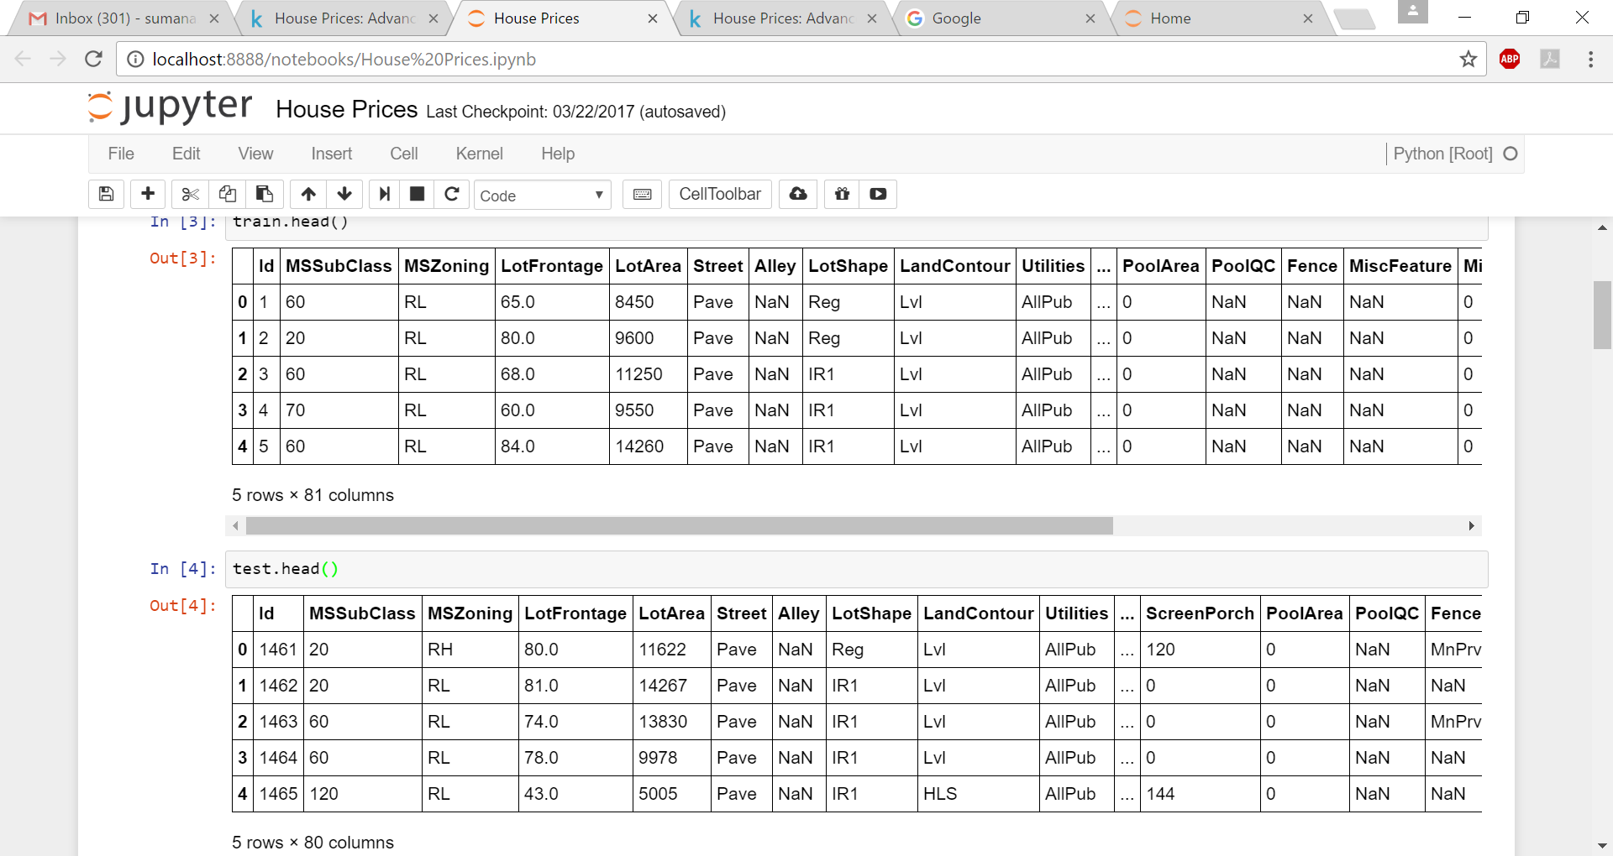
Datasets in Jupyter notebook
79 explanatory variables which describe every aspect of residential homes in Ames, Iowa.
Objective is to predict the final price of each home.
SalePrice is the target variable which is predicted here.
SalePrice is defined as the property’s sale price in dollars.

Slide 3
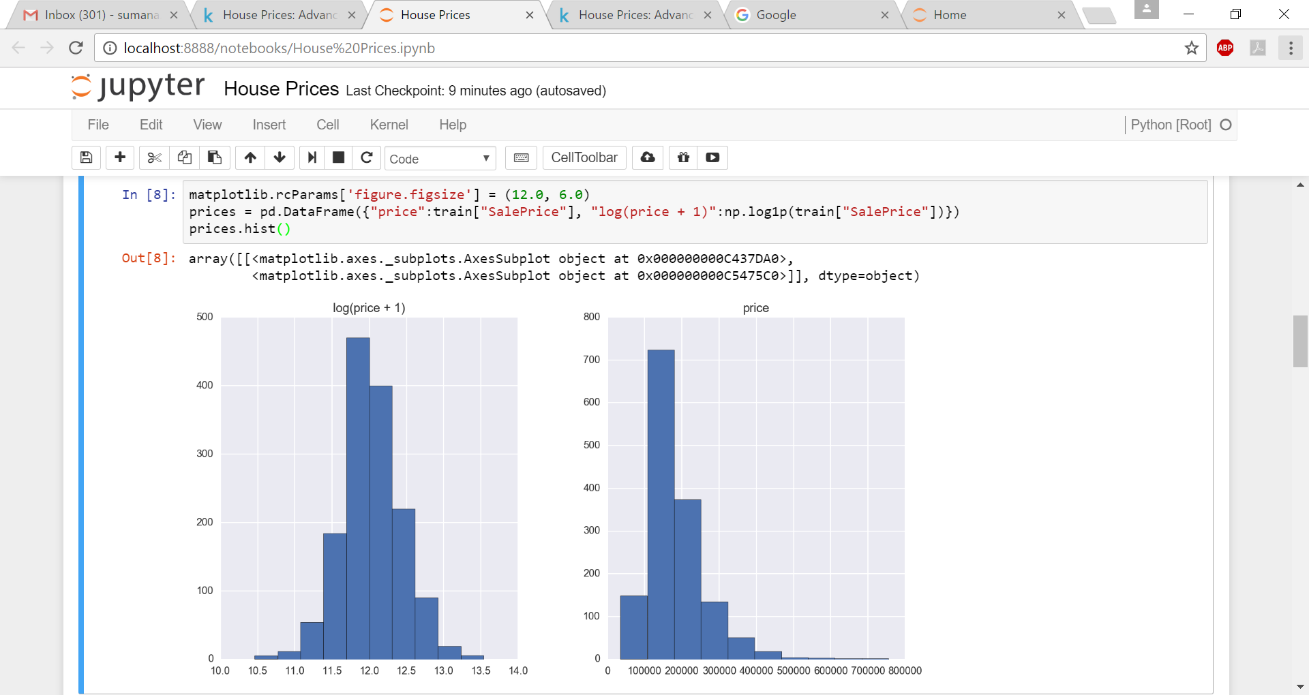
Log transformation of skewed SalePrice variable

Slide 4
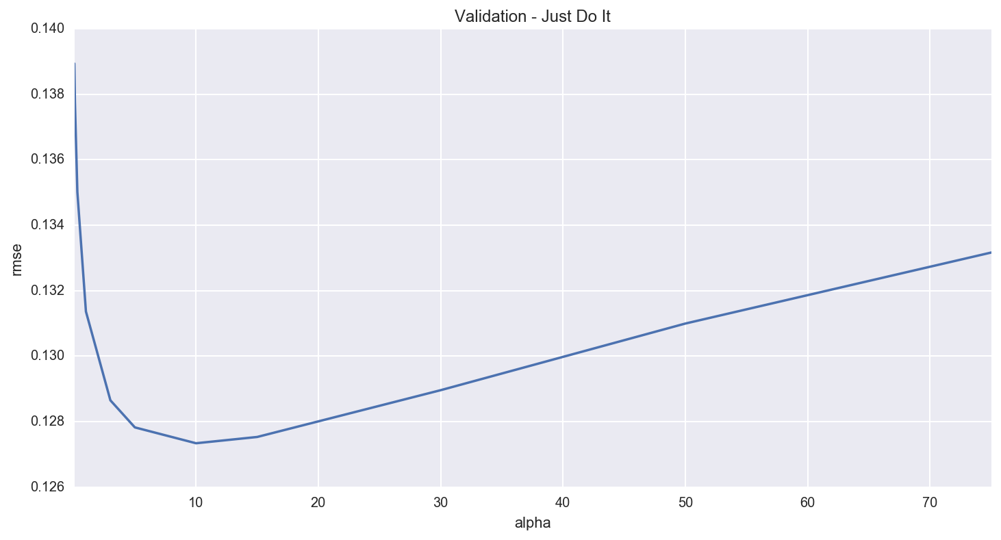
Ridge Model Implementation
For the Ridge regression model we get a rmse of about 0.127
The U-ish shaped curve indicates when alpha is too large the regularization is too strong and the model cannot capture all the complexities in the data. However, when alpha is small then the model begins to overfit.

Slide 5
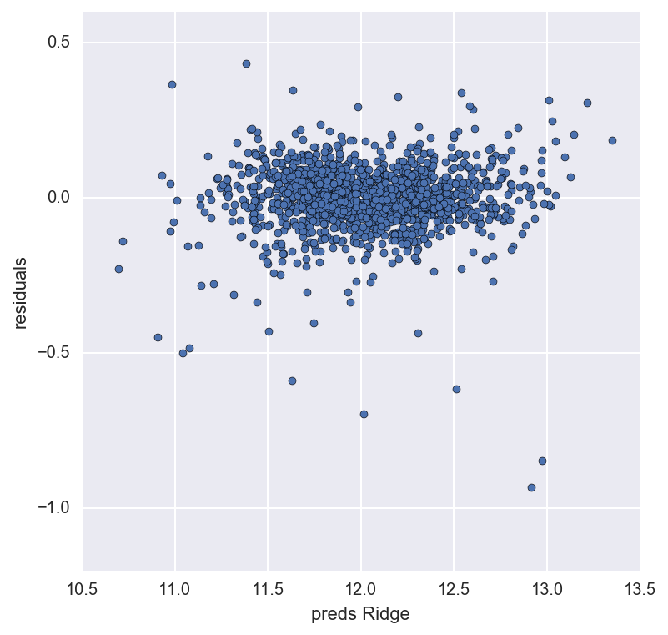
Residuals of Ridge model
Residual plot looks fine

Slide 6
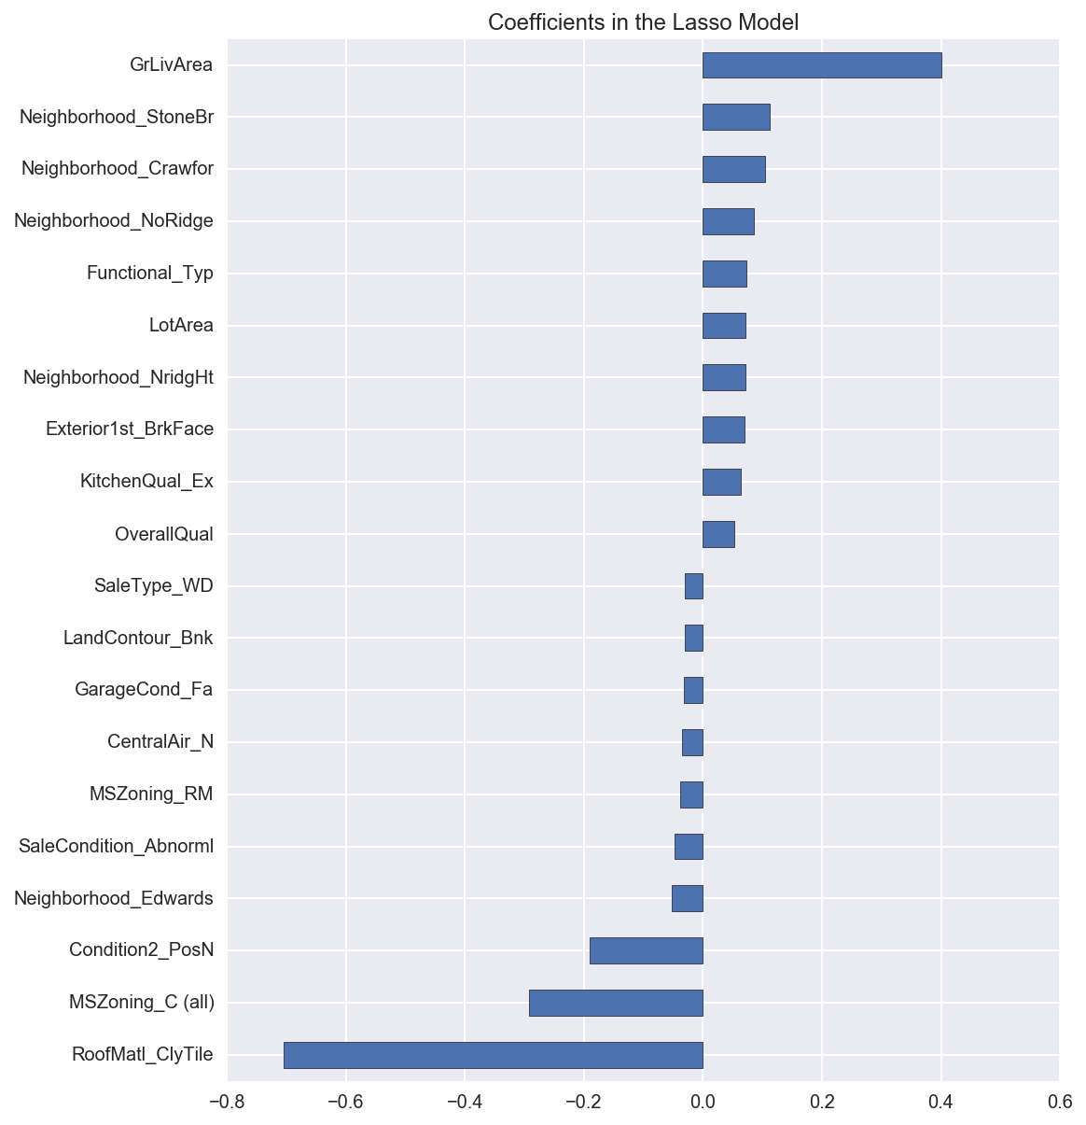
Important Coefficients
For the Lasso regression model we get a rmse of about 0.123
Thus the Lasso model performs better than the Ridge
The most important positive feature is GrLivArea - the above ground area by area square feet.

Slide 7
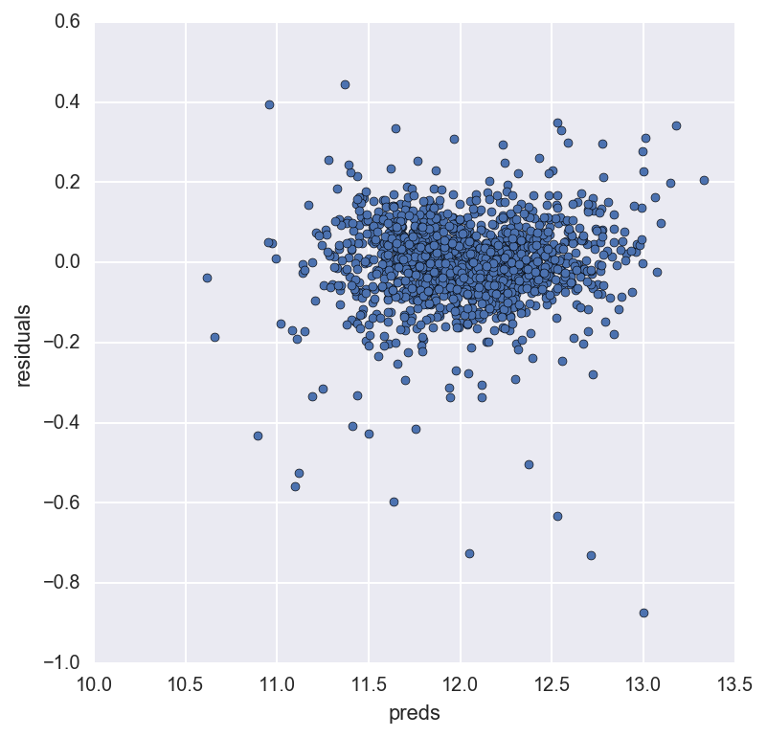
Residuals of Lasso model
Residual plot looks good

Slide 8
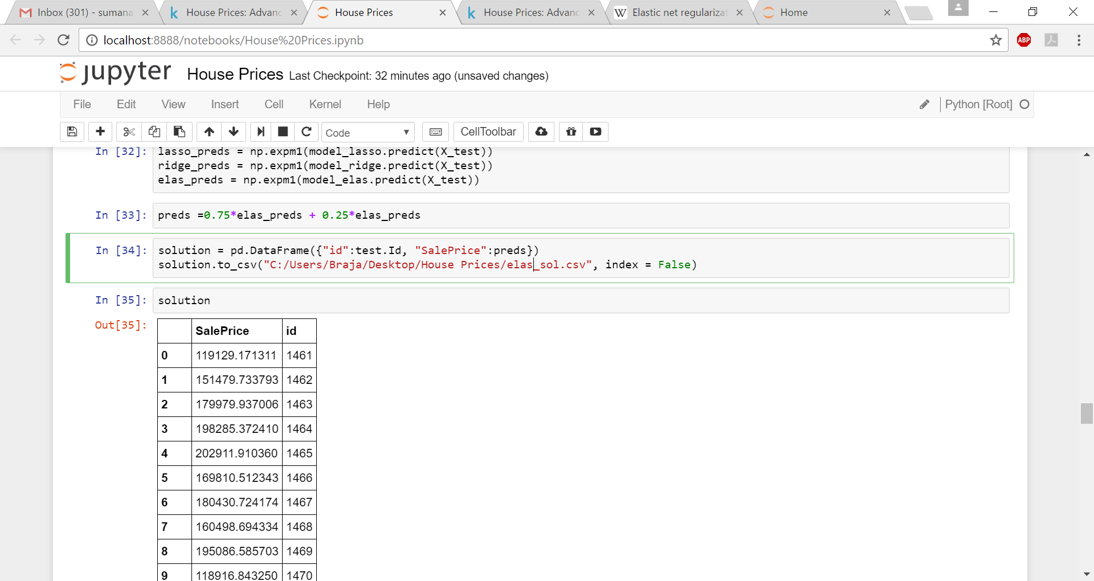
Elastic net regularization model
rmse_cv(model_elas).mean() : 0.12289939197911479
Finally prices of homes in Ames are predicted which is given by the Data frame “solution”

